Slide 1

Linux Fundamentals VERSION 3 Part 3 Eng Ali Mohammad. Bani Bakkar

Slide 2
Control Operators

Slide 3
semicolon
You can put two or more commands on the same line separated by a semicolon ; .
$ echo Hello
Hello
$ echo World
World
$ echo Hello ; echo World
Hello
World

Slide 4
ampersand
When a line ends with an ampersand &, the shell will not wait for the command to finish.
You will get your shell prompt back, and the command is executed in background. You will get a message when this command has finished executing in background.
$ sleep 20 & ls -1
[1] 7925
$
...wait 20 seconds...
$
[1]+ Done sleep 20

Slide 5
$? dollar question mark
The exit code of the previous command is stored in the shell variable $?. Actually $? is a shell parameter and not a variable, since you cannot assign a value to $?.
$ touch file1
$ echo $?
0
$ rm file1
$ echo $?
0
$ rm file1
rm: cannot remove `file1': No such file or directory
$ echo $?
1
$

Slide 6
&& double ampersand
The shell will interpret && as a logical AND. When using && the second command is executed only if the first one succeeds (returns a zero exit status).
$ echo first && echo second
first
second
$ zecho first && echo second
-bash: zecho: command not found
Another example of the same logical AND principle. This example starts with a working cd followed by ls, then a non-working cd which is not followed by ls.
$ cd gen && ls
file1 file3 File55 fileab FileAB fileabc
file2 File4 FileA Fileab fileab2
$ cd gen && ls
-bash: cd: gen: No such file or directory

Slide 7
|| double vertical bar
The || represents a logical OR. The second command is executed only when the first command fails (returns a non-zero exit status).
$ echo first || echo second ; echo third
first
third
$ zecho first || echo second ; echo third
-bash: zecho: command not found
second
third
Another example of the same logical OR principle.
$ cd gen || ls
$ cd gen || ls
-bash: cd: gen: No such file or directory
file1 file3 File55 fileab FileAB fileabc
file2 File4 FileA Fileab fileab2

Slide 8
combining && and ||
You can use this logical AND and logical OR to write an if-then-else structure on the command line. This example uses echo to display whether the rm command was successful.
$ rm file1 && echo It worked! || echo It failed!
It worked!
$ rm file1 && echo It worked! || echo It failed!
rm: cannot remove `file1': No such file or directory
It failed!

Slide 9
# pound sign
Everything written after a pound sign (#) is ignored by the shell. This is useful to write a shell comment, but has no influence on the command execution or shell expansion.
$ mkdir test # we create a directory

Slide 10
end of line backslash
Lines ending in a backslash are continued on the next line. The shell does not interpret the newline character and will wait on shell expansion and execution of the command line until a newline without backslash is encountered.
$ echo This command line \
> is split in three \
> parts
This command line is split in three parts

Slide 11
Shell Variables

Slide 12
$ dollar sign
The shell will look for an environment variable named like the string following the dollar sign and replace it with the value of the variable (or with nothing if the variable does not exist).
shell variables are case sensitive!
These are some examples using $HOSTNAME, $USER, $UID, $SHELL, and $HOME.
$ echo This is the $SHELL shell
This is the /bin/bash shell
$ echo This is $SHELL on computer $HOSTNAME
This is /bin/bash on computer RHELv4u3.localdomain
$ echo The userid of $USER is $UID
The userid of ali is 500
$ echo My homedir is $HOME
My homedir is /home/ali

Slide 13
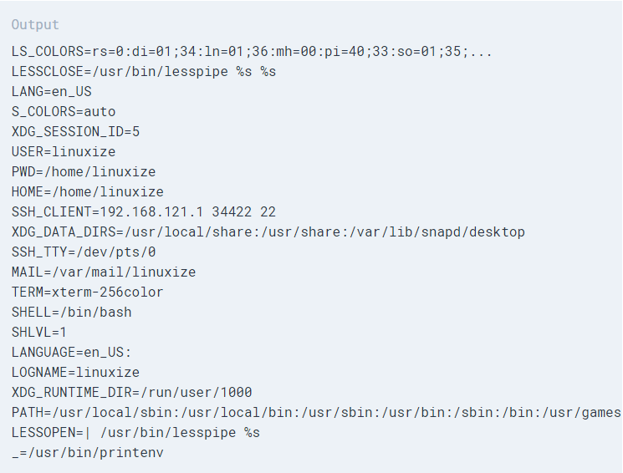
Environment Variables $env commandecho

Slide 14
Env
Echo $PATH
LS (WHERE DOES IT SEARCH?)
Make a file (content hello)
Try to run afile in different location
Add a location of a file to apath
Export PATH=location:$PATH
Now run the file(with out ./)

Slide 15
creating variables
This example creates the variable $MyVar and sets its value. It then uses echo to verify the value.
$ MyVar=555
$ echo $MyVar
555
How to add variables and print the sum?

Slide 16
A=“ali”
Echo $a
Bash
Echo $a
Exit
Echo $a
Now---- exit
Export A=“ali”
Echo $a
Bash
Echo $a
Exit
Echo $a
Now --- logout
Echo $a
env

Slide 17
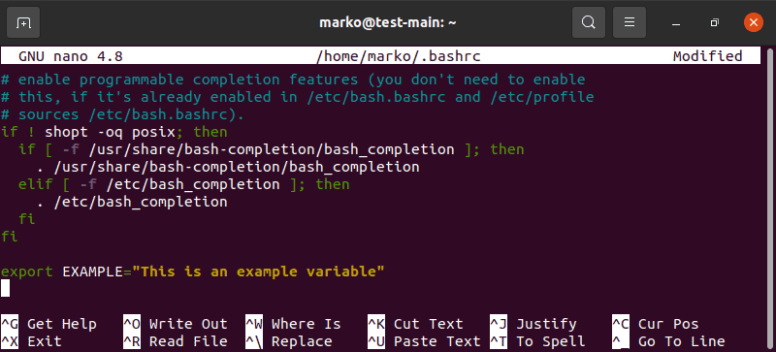
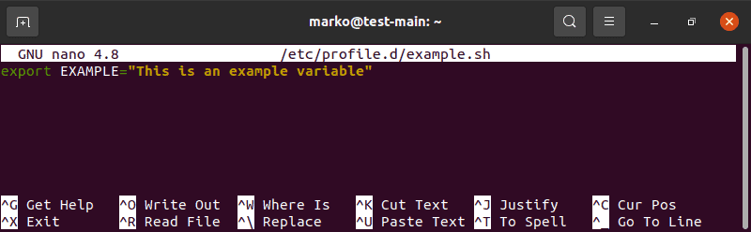
Set an Environment Variable in Linux Permanently
If you wish a variable to persist after you close the shell session, you need to set it as an environmental variable permanently. You can choose between setting it for the current user or all users.
1. To set permanent environment variables for a single user, edit the .bashrc file:
sudo nano ~/.bashrc
2. Write a line for each variable you wish to add using the following syntax:
export [VARIABLE_NAME]=[variable_value]
3. Save and exit the file. The changes are applied after you restart the shell. If you want to apply the changes during the current session, use the source command:
source ~/.bashrc
4. To set permanent environment variables for all users, create an .sh file in the /etc/profile.d folder:
sudo nano /etc/profile.d/[filename].sh
5. The syntax to add variables to the file is the same as with .bashrc:
6. Save and exit the file. The changes are applied at the next logging in

Slide 18
System Variable | Meaning | To View Variable Value Type
BASH_VERSION | Holds the version of this instance of bash. | echo $BASH_VERSION
HOSTNAME | The name of the your computer. | echo $HOSTNAME
CDPATH | The search path for the cd command. | echo $CDPATH
HISTFILE | The name of the file in which command history is saved. | echo $HISTFILE
HISTFILESIZE | The maximum number of lines contained in the history file. | echo $HISTFILESIZE
HISTSIZE | The number of commands to remember in the command history. The default value is 500. | echo $HISTSIZE
HOME | The home directory of the current user. | echo $HOME

Slide 19
IFS | The Internal Field Separator that is used for word splitting after expansion and to split lines into words with the read builtin command. The default value is <space><tab><newline>. | echo $IFS
LANG | Used to determine the locale category for any category not specifically selected with a variable starting with LC_. | echo $LANG
PATH | The search path for commands. It is a colon-separated list of directories in which the shell looks for commands. | echo $PATH
PS1 | Your prompt settings. | echo $PS1
TMOUT | The default timeout for the read builtin command. Also in an interactive shell, the value is interpreted as the number of seconds to wait for input after issuing the command. If not input provided it will logout user. | echo $TMOUT
TERM | Your login terminal type. | echo $TERM export TERM=vt100
SHELL | Set path to login shell. | echo $SHELL
DISPLAY | Set X display name | echo $DISPLAY export DISPLAY=:0.1
EDITOR | Set name of default text editor. | export EDITOR=/usr/bin/vim

Slide 20
quotes
Notice that double quotes still allow the parsing of variables, whereas single quotes prevent this.
$ MyVar=555
$ echo $MyVar
555
$ echo "$MyVar"
555
$ echo '$MyVar'
$MyVar
The bash shell will replace variables with their value in double quoted lines, but not in single quoted lines.
$ city=Burtonville
$ echo "We are in $city today."
We are in Burtonville today.
$ echo 'We are in $city today.'
We are in $city today.

Slide 21
unset
Use the unset command to remove a variable from your shell environment.
$ MyVar=8472
$ echo $MyVar
8472
$ unset MyVar
$ echo $MyVar

Slide 22
$PATH
The $PATH variable is determines where the shell is looking for commands to execute (unless the command is builtin or aliased).
$ echo $PATH
/usr/kerberos/bin:/usr/local/bin:/bin:/usr/bin:

Slide 23
Exercise
Unset PATH

Slide 24
delineate variables
Until now, we have seen that bash interprets a variable starting from a dollar sign, continuing until the first occurrence of a non-alphanumeric character that is not an underscore. In some situations, this can be a problem. This issue can be resolved with curly braces like in this example.
$ prefix=Super
$ echo Hello $prefixman and $prefixgirl
Hello and
$ echo Hello ${prefix}man and ${prefix}girl
Hello Superman and Supergirl

Slide 25
unbound variables
The example below tries to display the value of the $MyVar variable, but it fails because the variable does not exist. By default the shell will display nothing when a variable is unbound (does not exist).
$ echo $MyVar
There is, however, the nounset shell option that you can use to generate an error when a variable does not exist.
$ set -u
$ echo $Myvar
bash: Myvar: unbound variable
$ set +u
$ echo $Myvar

Slide 26
history
To see older commands, use history to display the shell command history
History n to see the last n commands).
$ history 10
38 mkdir test
39 cd test
40 touch file1
41 echo hello > file2
42 echo It is very cold today > winter.txt
43 ls
44 ls -l
45 cp winter.txt summer.txt
46 ls -l
47 history 10

Slide 27
History !n
When typing ! followed by the number preceding the command you want repeated, then the
shell will echo the command and execute it.
$ !43
ls
file1 file2 summer.txt winter.txt

Slide 28
History
All commands are kept in .bash_history
Cat .bash_history

Slide 29
$HISTSIZE
The $HISTSIZE variable determines the number of commands that will be remembered in your current environment. Most distributions default this variable to 500 or 1000.
$echo $HISTSIZE

Slide 30
prevent recording a command
You can prevent a command from being recorded in history using a space prefix.
$ echo abc
abc
$ echo def
def
$ echo ghi
ghi
$ history 3
9501 echo abc
9502 echo ghi
9503 history 3

Slide 31
File Globbing

Slide 32
file globbing
The shell is also responsible for file globbing (or dynamic filename generation).

Slide 33
Regular Expressions (RegEx)

Slide 34
Usage
Regexps are acronyms for regular expressions. Regular expressions are special characters or sets of characters that help us to search for data and match the complex pattern.

Slide 35
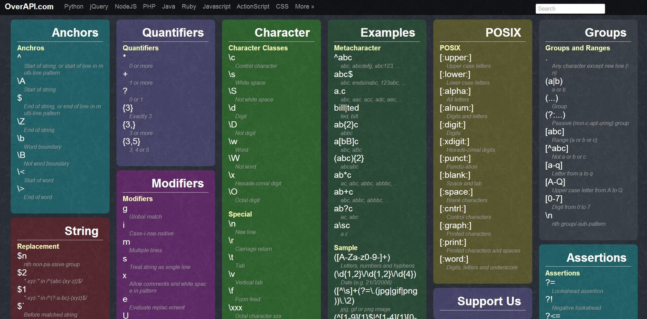

Slide 36
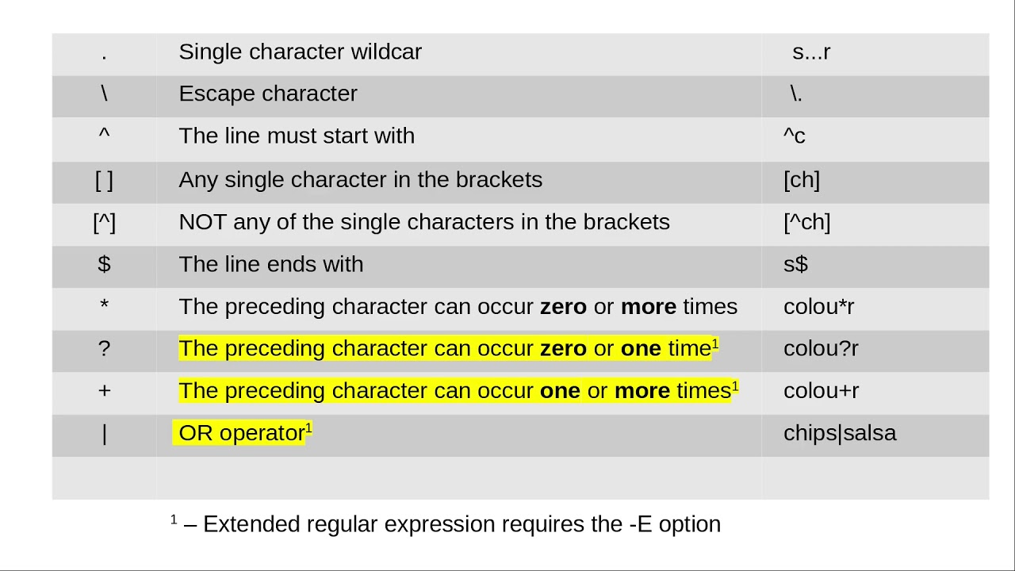

Slide 37
Using “.” (dot)
Using “.” we can find a string if we do not know the exact string, or we just remember only the start and end of the string, we can use “.” As a missing character, and it will fill that missing character.
fruits_file=`cat fruit.txt | grep App.e`

Slide 38
Using “^” (caret) to match the beginning of the string
Using “^”, we can find all the strings that start with the given character. Let’s see an example for a better understanding. Here we are trying to find all the fruit names that start with the letter B:
fruits_file=`cat fruit.txt | grep ^B`

Slide 39
Using “$” (dollar sign) to match the ending of the string
Using “$” we can find all the strings that end with the given character. Let’s see an example for a better understanding. Here we are trying to find all the fruit’s names that end with the letter e:
fruits_file=`cat fruit.txt | grep e$`

Slide 40
Using “*” (an asterisk) to find any number of repetitions of a string
Using “*”, we can match up to zero or more occurrences of the character of the string. Let’s see an example for a better understanding. Here we are trying to find all the fruit’s names that has one or more occurrences of ‘ap’ one after another in it.
fruits_file=`cat fruit.txt | grep ap*le`

Slide 41
Using “\” (a backslash) to match the special symbol
Using “\” with special symbols like whitespace (” “), newline(“\n”), we can find strings from the file. Let’s see an example for a better understanding. Here we are trying to find all the fruit’s names that have space in their full names
fruits_file=`cat fruit.txt | grep “\ “`

Slide 42
Using “()” (braces) to match the group of regexp.
Using “()”, we can find matched strings with the pattern in the “()”. Let’s see an example for a better understanding. Here we are trying to find all the fruit’s names that have space in their full name
fruits_file=`cat fruit.txt | grep -E “(fruit)”`

Slide 43
Using “?”(question mark) to find all the matching characters
Using “?”, we can match 0 or 1 repetitions of the preceding. For example, if we do something like this: ab? It will match either ‘a’ or ‘ab’. Let’s see another example for better understanding. Here we are trying to find all the fruit’s names that have the character ‘Ch’ in them.
fruits_file=`cat fruit.txt | grep -E Ch?`

Slide 44
* asterisk
The asterisk * is interpreted by the shell as a sign to generate filenames, matching the asterisk
to any combination of characters (even none). When no path is given, the shell will use
filenames in the current directory.
$ ls
file1 file2 file3 File4 File55 FileA fileab Fileab FileAB fileabc
$ ls File*
File4 File55 FileA Fileab FileAB
$ ls file*
file1 file2 file3 fileab fileabc
$ ls *ile55
File55
$ ls F*ile55
File55
$ ls F*55
File55

Slide 45
? question mark
Similar to the asterisk, the question mark ? is interpreted by the shell as a sign to generate
filenames, matching the question mark with exactly one character.
$ ls
file1 file2 file3 File4 File55 FileA fileab Fileab FileAB fileabc
$ ls File?
File4 FileA
$ ls Fil?4
File4
$ ls Fil??
File4 FileA
$ ls File??
File55 Fileab FileAB

Slide 46
[] square brackets (1)
The square bracket [ is interpreted by the shell as a sign to generate filenames, matching any of the characters between [ and the first subsequent ]. The order in this list between the brackets is not important. Each pair of brackets is replaced by exactly one character.
$ ls
file1 file2 file3 File4 File55 FileA fileab Fileab FileAB fileabc
$ ls File[5A]
FileA
$ ls File[A5]
FileA
$ ls File[A5][5b]
File55
$ ls File[a5][5b]
File55 Fileab
$ ls File[a5][5b][abcdefghijklm]
ls: File[a5][5b][abcdefghijklm]: No such file or directory
$ ls file[a5][5b][abcdefghijklm]
fileabc

Slide 47
[] square brackets (2)
You can also exclude characters from a list between square brackets with the exclamation
mark !. And you are allowed to make combinations of these wild cards.
$ ls
file1 file2 file3 File4 File55 FileA fileab Fileab FileAB fileabc
$ ls file[a5][!Z]
fileab
$ ls file[!5]*
file1 file2 file3 fileab fileabc

Slide 48
a-z and 0-9 ranges
The bash shell will also understand ranges of characters between brackets.
$ ls
file1 file3 File55 fileab FileAB fileabc
file2 File4 FileA Fileab fileab2
$ ls file[a-z]*
fileab fileab2 fileabc
$ ls file[0-9]
file1 file2 file3
$ ls file[a-z][a-z][0-9]*
fileab2

Slide 49
I/O redirection

Slide 50
I/O redirection
input/output redirection
error streams.
pipes.

Slide 51
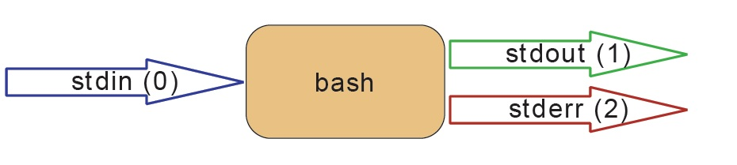
stdin, stdout, and stderr
The bash shell has three basic streams; it takes input from stdin (stream 0), it sends output
to stdout (stream 1) and it sends error messages to stderr (stream 2) .
The drawing below has a graphical interpretation of these three streams.

Slide 52

The keyboard often serves as stdin, whereas stdout and stderr both go to the display.

Slide 53
stdout
stdout can be redirected with a greater than sign. While scanning the line, the shell will see the > sign and will clear the file.
$ echo It is cold today!
It is cold today!
$ echo It is cold today! > winter.txt
$ cat winter.txt
It is cold today!

Slide 54
output file is erased
While scanning the line, the shell will see the > sign and will clear the file! Since this happens before resolving argument 0, this means that even when the command fails, the file will have been cleared!
$ cat winter.txt
It is cold today!
$ zcho It is cold today! > winter.txt
-bash: zcho: command not found
$ cat winter.txt

Slide 55
noclobber
Erasing a file while using > can be prevented by setting the noclobber option.
$ cat winter.txt
It is cold today!
$ set -o noclobber
$ echo It is cold today! > winter.txt
-bash: winter.txt: cannot overwrite existing file
$ set +o noclobber

Slide 56
overruling noclobber
The noclobber can be overruled with >|.
$ set -o noclobber
$ echo It is cold today! > winter.txt
-bash: winter.txt: cannot overwrite existing file
$ echo It is very cold today! >| winter.txt
$ cat winter.txt
It is very cold today!

Slide 57
>> append
Use >> to append output to a file.
$ echo It is cold today! > winter.txt
$ cat winter.txt
It is cold today!
$ echo Where is the summer ? >> winter.txt
$ cat winter.txt
It is cold today!
Where is the summer ?

Slide 58
stderr
Redirecting stderr is done with 2>. This can be very useful to prevent error messages from cluttering your screen.
The screenshot below shows redirection of stdout to a file, and stderr to /dev/null. Writing 1> is the same as >.
$ find / > allfiles.txt 2> /dev/null

Slide 59
Example
Echo “jordan”>file1.txt
Ls –l file1.txt>file2.txt 2>fileerror.txt

